Slide 1
Chapter 1: The Evolution of Mobile Application INTRODUCTION TO MOBILE APPLICATION (TSE3383)

Slide 2
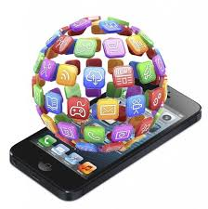
What is a Mobile Application?
Mobile application is a software application designed to run on mobile devices such as smartphones and tablet computers. It is a result of recent technological innovations.
Mobile applications have appeared because of the convergence of media, information technology, Internet and advanced technologies.
It is a computer generated programmed design and developed to run on iPhone, Smartphones, tablets and many other mobile devices.

Slide 3
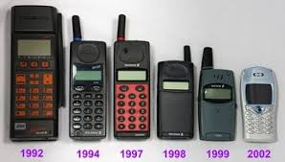
History of Mobile Application
Mobile communication is so integrated into our lives that many people feel uncomfortable without a cell phone.
Several years ago, the most popular functions of phones were calling and sending texts.
A smart phone is a multifunctional device that not only communicates, but helps to learn, earn, and have fun.
This is made possible by the development of mobile applications

Slide 4
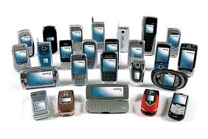
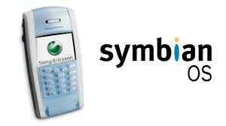
History of Mobile Application (cont..)
Mobile applications date back to the end of the twentieth century.
Typically, they were small arcade games, ring tone editors, calculators, calendars, and so forth.
The beginning of the new millennium saw a rapid market evolution of mobile content and applications.
Operating systems for smart phones (Windows Mobile, Symbian, RIM, Android, Mac iOS), are open to the development of third-party software, unlike the conventional programming environment of standard cell phones

Slide 5
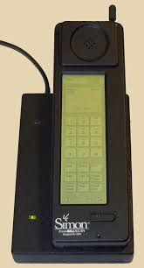
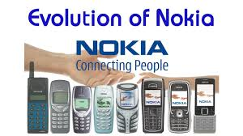
History of Mobile Application (cont..)
The first smart phone was released for the general use by IBM in 1993 that was equipped with the feature like calculator, calendar, world clock and contact book.
Nokia was one of the pioneers of mobile gaming due to the popularity of Snake, which came pre-loaded on many products.

Slide 6
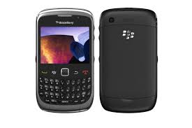
History of Mobile Application (cont..)
The BlackBerry Smart phone announced in 2002 was the next major role in the field of mobile application development and it was marked by BlackBerry Limited, formerly known as Research in Motion Limited (RIM) and integrated with the innovative concepts of wireless email.

Slide 7
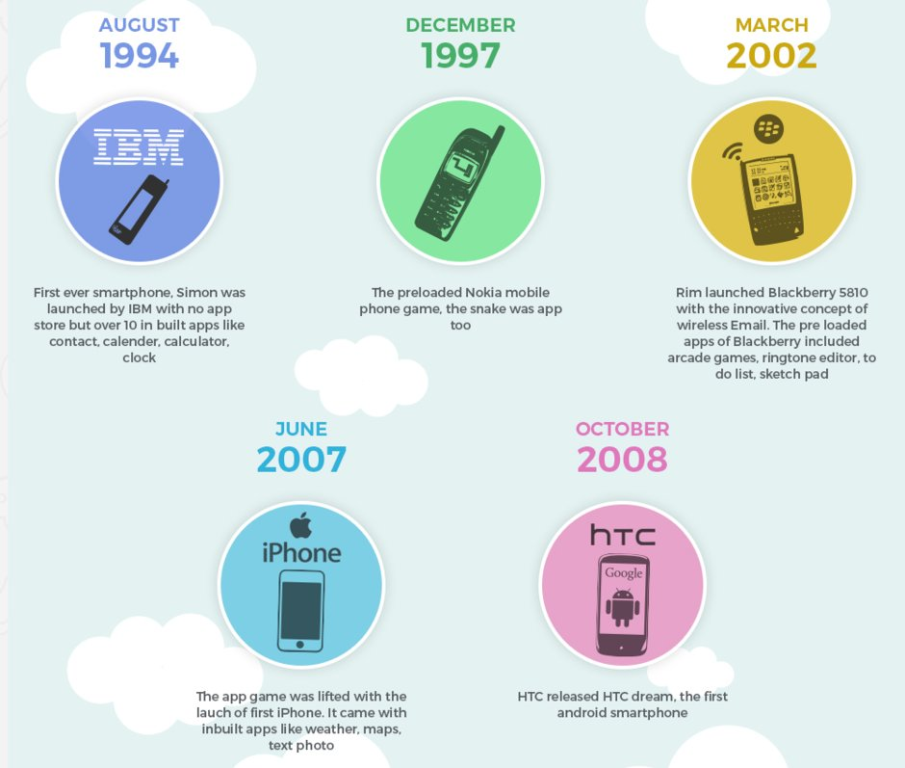

Slide 8
CLASS DISCUSSION
Choose one early model of smart phone and find some information about the phone.
When was the model phone invented?
What kind of OS used by the model
What are features and mobile application introduce by the model?
https://padlet.com/anis_juanita/mb_discuss

Slide 9
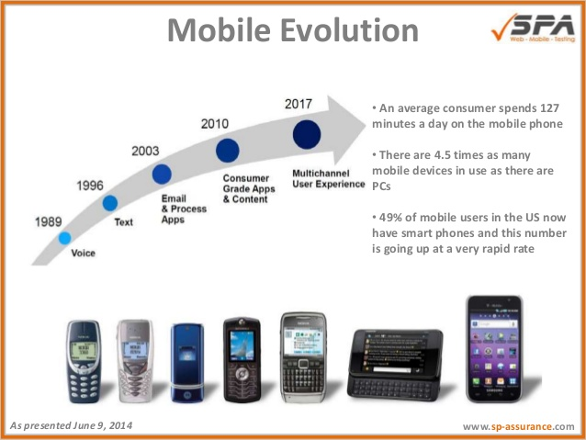
Evolution of Mobile Apps Development

Slide 10
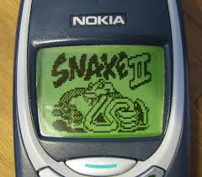
History of Mobile Apps Developer
The first used apps were mostly the monthly calendars, calculators and even games that were developed in the Java framework. But, interestingly, the first-ever known smartphone was launched by IBM in the year 1993. And, it came with features such as the contact book, calendar, world clock and calculator.
In 1997, the Nokia 6110 included a built-in version of the basic arcade game “Snake”.

Slide 11

History of Mobile Apps Developer (cont..)
According to a report, “There were 20 billion software developers across the world in the year 2015, and the number would grow to a whopping 25 billion by 2020”.
Nowadays, India, Russia and China are seeing fast growth in the number of mobile apps developers in compared to the first world countries that produced more mobile applications developers once.

